Slide 1

RAINFALL PREDICTION USING MACHINE LEARNING
Project Supervisor: Dr. S.Dhamodaran, M.E., Ph.D.,
Name of the Student: Mr. V.L.V.Prayush
Register Number: 39110800

Slide 2
Presentation Outline
Course Certificate
Introduction
Objectives
System Architecture / Ideation Map
Module Implementation
Application Snapshots
Results and Discussions
Conclusion & Future work
References

Slide 3
Course Certificate
Attach your Course Certificate here

Slide 4
Introduction
Rainfall Prediction is the application of science and
technology to predict the amount of rainfall over a region.
It is important to exactly determine the rainfall for effective use of water resources, crop productivity and pre-planning of water structures.
Rainfall prediction using Machine Learning for the given dataset
For finding the solution we used Linear regression Algorithm

Slide 5
Objectives
The objective of this project is to predict the rainfall and plot in the graph.
The given problem is a regression based problem.
In machine learning im going to use Linear regression to achieve our objective.
By using linear regression we get the objective and shown in the form of graph and predicted values.

Slide 6
System Architecture / Ideation Map
START
Rainfall dataset
Data visualization
Normalizing the data
By using linear regression training the data
Train
(80%)
Stop
Predicting data by using linear regression
Test
(20%)
Result

Slide 7
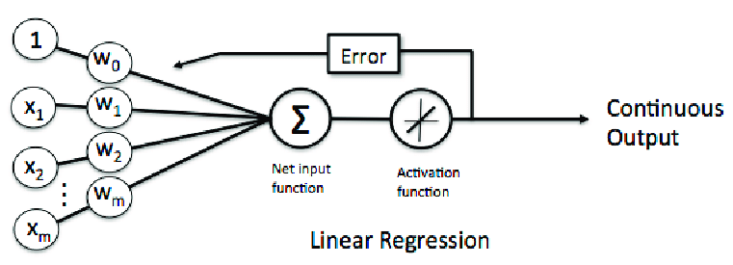
System Architecture / Ideation Map

Slide 8
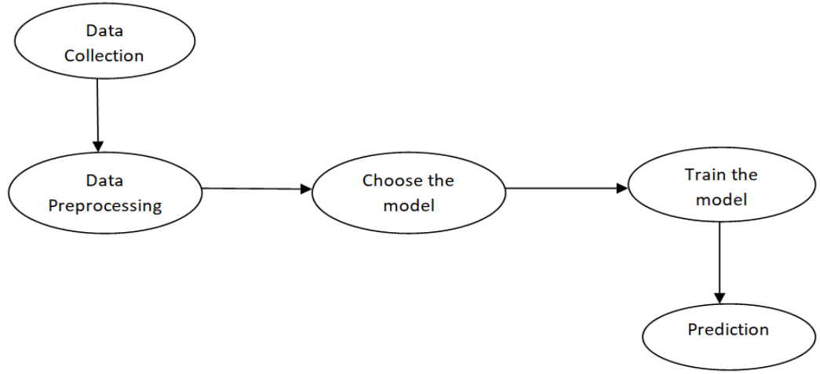
Project Implementation
MODULE IMPLEMENTATION:
To predict the rainfall, we need to build a machine learning model which includes the following steps

Slide 9
Project Implementation
Data Collection: The first thing required while building a machine learning model is the data. We are collecting the data from the web
Data Preprocessing: Data preprocessing is required when the data is incomplete, inconsistent, or noisy. The data collected was noisy, so we performed an outlier analysis and removed the noisy data. The data transformation is also done by performing normalization in which the data in each attribute is scaled between the range 0 to 1.
Choose the model: Prediction of gold price is a regression task, so we consider the regression algorithm called Linear regression algorithm for building the model.

Slide 10
Project Implementation
Training&Testing : The model is trained by importing the required model and bypassing the training data to it. The dataset is splitted into train and test data with test_size=0.20. The Linear regression modules are imported from sklearn.ensemble.
Linear regression is a continous data it predicts the continous values so we selected for this problem.
Applying the modules to the splitted data.
Predicting the output data and shown in graphs and values.

Slide 11
Project Implementation
System Specification :
This section demonstrates the Rainfall Prediction Model's most prominent features and explains how they can be used and the results they will give back to the user.
Hardware Requirements :
The minimum hardware requirements of Rainfall prediction are a 500 Megahertz CPU and 128megabytes of RAM. Also, because this model uses python libraries to speed up the prediction. A system with a large amount of memory for training and testing data.

Slide 12
Project Implementation
2) Software Requirements :
Windows 2000
Windows XP
Windows Vista
Windows 7
Windows 8
Windows 10
Mac OS X
-Anaconda server
-Jupiter notebook
-Google collab
-visual studio

Slide 13
Project Implementation
Construction :
Problem statement
Importing the libraries
Loading the dataset
Data Insights
Summary Statistics
Data visualization
Understanding the target variable
Fitting the Models
Checking model accuracy

Slide 14
Project Implementation
Interpretation of result:
Machine learning models achieved significantly higher prediction accuracy
over common clinical risk scores , By using the linear regression model we achieved mean absolute difference accuracy>0.85 in all the types we used in the problem. But we got mean absolute error 95% by using the data.

Slide 15
Methodology
To achieve my project’s objective ,In machine learning we used linear regression algorithm.
LINEAR REGRESSION:
Linear regression algorithm shows a linear relationship between a dependent (y) and one or more independent (y) variables, hence called as linear regression. Since linear regression shows the linear relationship, which means it finds how the value of the dependent variable is changing according to the value of the independent variable.

Slide 16
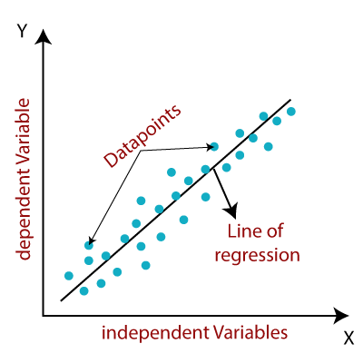
Methodology
The linear regression model provides a sloped straight line representing the relationship between the variables.

Slide 17
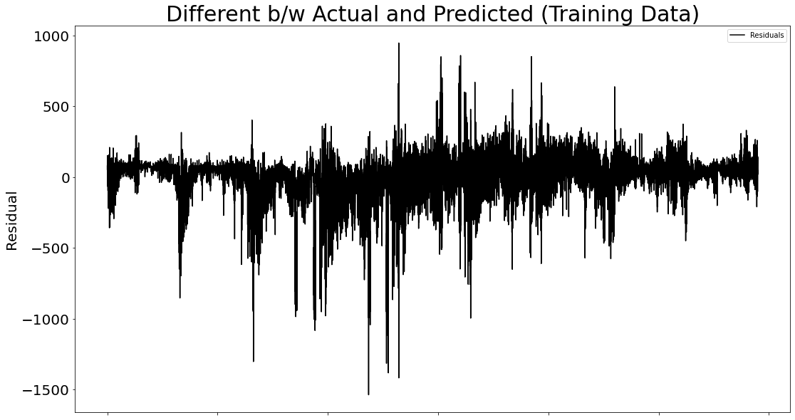
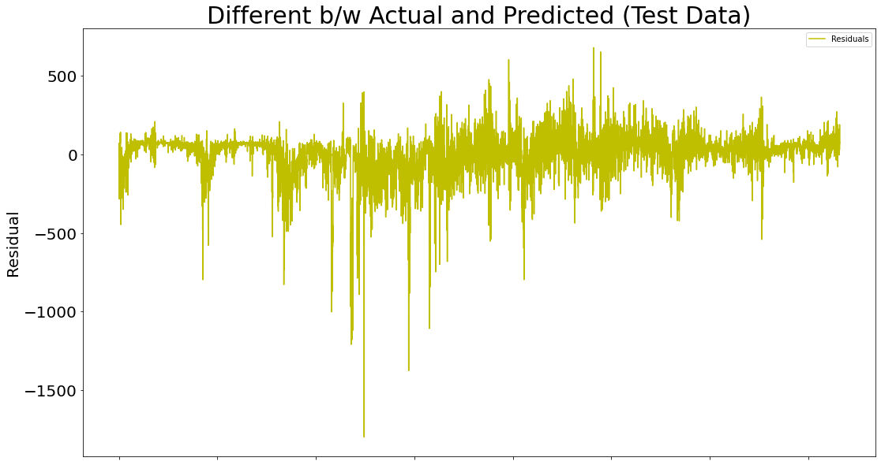
Results and Discussion
Prediction using Linear Regression:
Single Linear Model on Whole Data Ignoring Subdivision
MAD (Training Data): 94.18912194999176
MAD (Test Data): 92.43710424626344

Slide 18
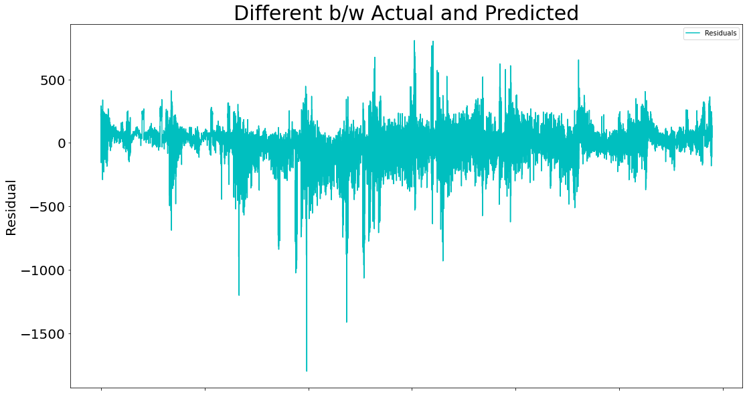
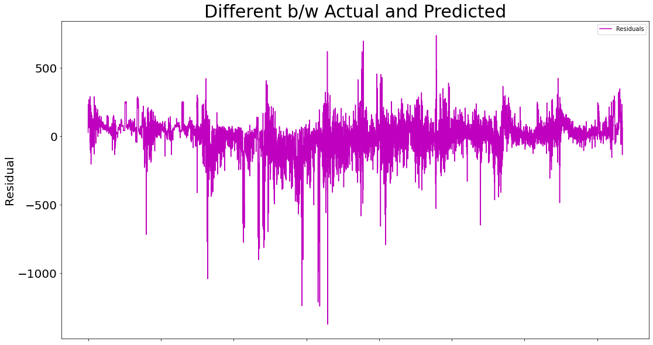
Results and Discussion
Single Linear Model on Whole Data Including Subdivision:
MAD (Training Data):87.84000928365698
MAD (Test Data):89.24715743846383

Slide 19
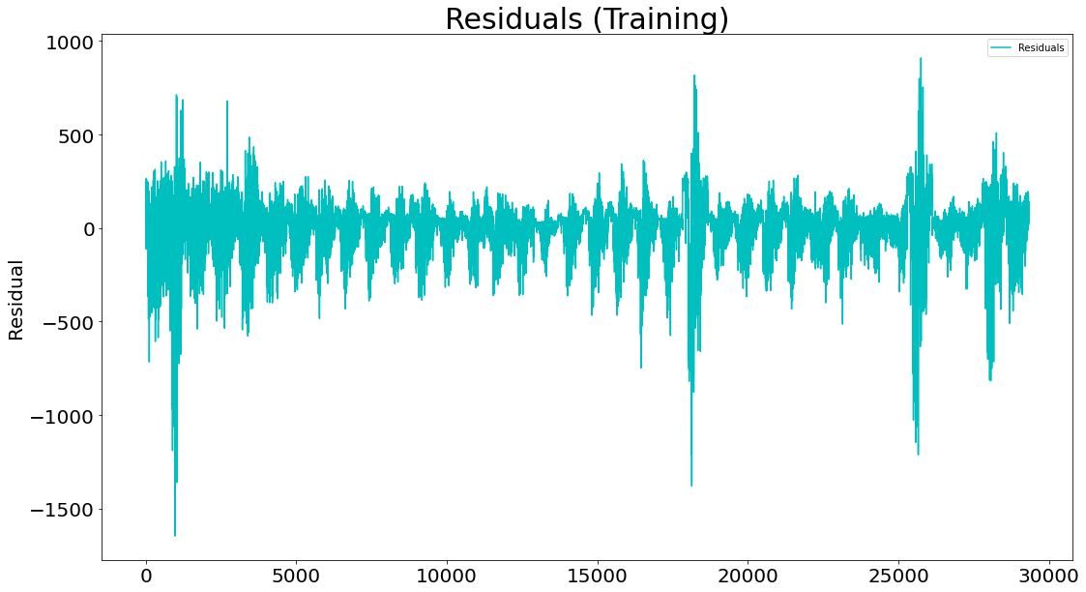
Results and Discussion
Linear Model Fitted to Each Subdivision Category Independently:
Overall MAD (Training): 86.88207079662646

Slide 20
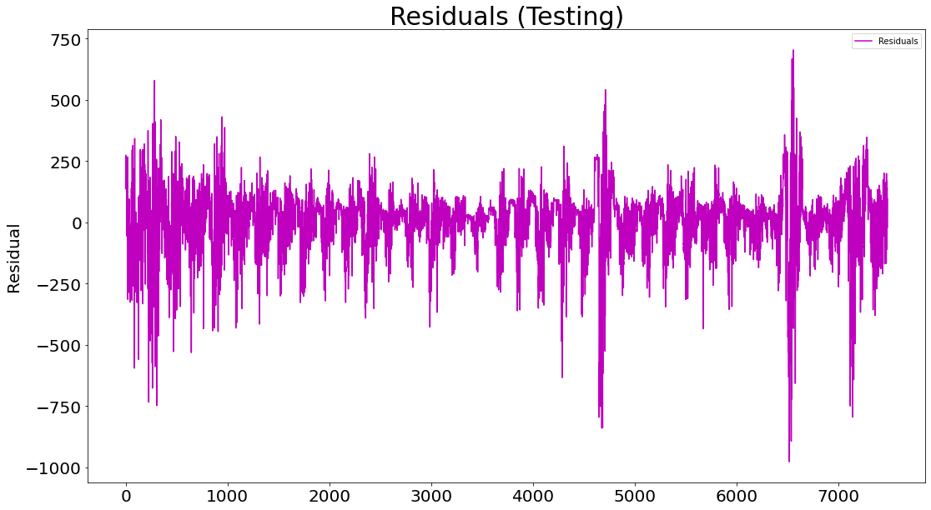
Results and Discussion
Linear Model Fitted to Each Subdivision Category Independently:
Overall MAD (Testing): 85.16228884188341

Slide 21
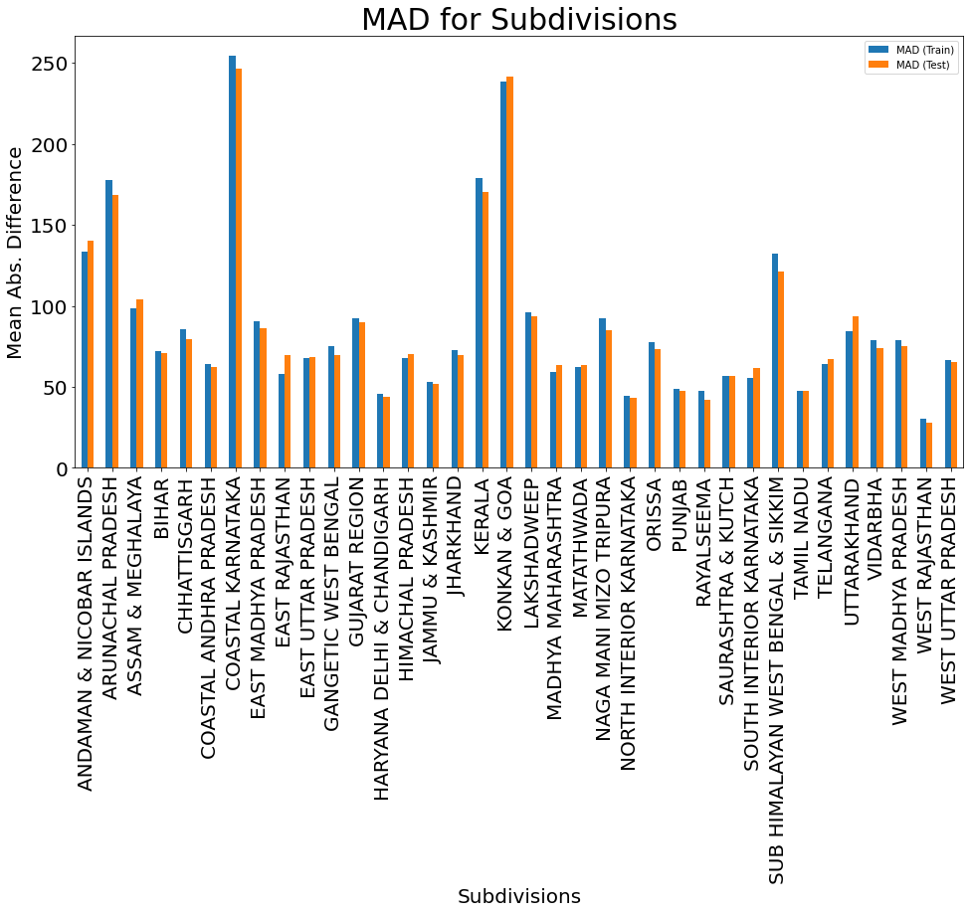
Results and Discussion
Linear Model Fitted to Each Subdivision Category Independently:

Slide 22
Conclusion
Rainfall being one of the sole responsibilities for maximum economy of India, it should be considered the primary concern for most of us.
The current approach for rainfall prediction fails in most of the complex cases.
By using linear regression algorithm we got approximately 87% mean absolute difference
Simillarly if we taken any particular subdivision in the data and calculated the model accuracy we will get difference in accuracy from place to place.

Slide 23
Conclusion
The accuracy of the algorithm can be additionally tested on increase in the complexity.
Henceforth, algorithm for testing daily basis dataset instead of accumulated dataset could be of paramount Importance for further research.
More the accuracy of the system used for rainfall prediction, smarter will be the agriculture. Along with that, this will be an efficient tool for people in coastal areas of the country thereby making them well aware of the situation in advance.

Slide 24
References
[1] | Pinar Ozturk. (n.d.). Flood Prediction Using Machine Learning Models: Literature Review. Retrieved from https://www.mdpi.com/2073-4441/10/11/1536
[2] | Python tutorial. (n.d.). Retrieved April 9, 2022, from https://www.tutorialspoint.com/python/index.htm
[3] | Liyew, C. M., & Melese, H. A. (2021, December 7). Machine learning techniques to predict daily rainfall amount - Journal of Big Data. SpringerOpen. Retrieved April 9, 2022, from https://journalofbigdata.springeropen.com/articles/10.1186/s40537-021-00545-4
[4] | Zeyi Chao, Fangling Pu, Yuke YinLing, B. and X. (2018). Research on real-time local rainfall prediction based on MEMS sensors. Journal of Sensors, 2018. https://doi.org/10.1155/2018/6184713

Slide 25
References
[5] | Etuk, E. H., & Mohamed, T. M. (2014). Time Series Analysis of Monthly Rainfall data for the Gadaref rainfall station, Sudan, by Sarima Methods. International Journal of Scientific Research in Knowledge, July, 320–327. https://doi.org/10.12983/ijsrk-2014- p0320-0327
[6] | Flood prediction using Machine Learning Models: Literature review - researchgate. (n.d.). Retrieved April 9, 2022, from https://www.researchgate.net/publication/335094911_Flood_Prediction_Using_Machine_Learning_Models_Literature_Review
[7] | A flood prediction system developed using various machine ... (n.d.). Retrieved April 9, 2022, from https://www.researchgate.net/publication/352448189_A_Flood_Prediction_System_Developed_Using_Various_Machine_Learning_Algorithms
[8] | M. A. Sharma and J. B. Singh, “Comparative Study of rainfall orecasting models,” New York Sci. J., pp. 115- 120, 2011.

